Slide 1

Implementing an Automation tool to improve the Quality of customer Data for PiLog groups.
Submitted by: Mohammed Mutahar Shaik (mmshaik1@ualr.edu)
Dpartment of Information Science, Spring 2023 Master’s Project

Slide 2
Supervisory Committee
Committee Chair & Faculty Advisor: Dr. John R Talburt (jrtalburt@ualr.edu)
Sponsoring Organization: PiLog Groups
Committee Member & Sponsoring Supervisor & Business Consultant: Leon Claassens
(leon.Claassens@pilog.co.za)
Information Science,
University of Arkansas at Little Rock
Department of Information Science, Spring 2023 Master’s Project
2

Slide 3
Introduction
IBM estimated that poor quality data cost the company $3.1 trillion in the U.S. alone in 2016.
IBM emphasizes the value of good data quality for business outcomes & offers tools to help, like data governance and cleansing.
Department of Information Science, Spring 2023 Master Project
3

Slide 4
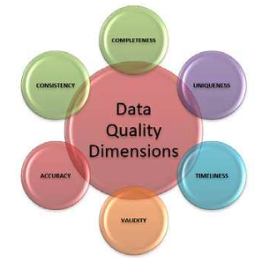
Introduction
Information Quality:
Maximizing the value and minimizing the risk of an organization’s information assets
• Assuring the information products produced by the organization create value for the people and systems who use them
Term data Quality Dimension has wide definitions
to describe a features of data that can be measured or assessed against defined standards in order to determine the quality of data.
Term data quality dimension is taken to mean: some thing (data item, record, data set or database) that can either be measured or assessed
in order to understand the quality of data
Department of Information Science, Spring 2023 Master’s Project
4

Slide 5
Agenda - To measure and improve the impact of poor data Quality in terms of 3 data Quality dimensions
Completeness
Validity
Uniqueness
Department of Information Science, Spring 2023 Master’s Project

Slide 6

Data Collection
Synthetic data is generated from Mockaroo website for tesing the data later it is tested on Organisational Customer Data.
https://www.mockaroo.com/
List of attributes of Customer Data are:
customer_ID,
prefix,
first_name,
last_name,
generationalSuffix,
suffixTitle,
CompleteName,
gender,email,Address1,Address2,city,state,zipcode,country,Race,Birth_Date,Marrital_Status,Number_of_Children,Mobile,SSN,Store_Membership_Card,Occupation,Annual_Income,Largest_Bill_Amount,Mean_Transaction_Amount,Transaction_ID,Last_Transaction,customer_Since,IntBankAccNo,CreditcardNo,CreditCard_type,password
Department of Information Science, Spring 2023 Master’s Thesis
6

Slide 7
Project FlowChart
Understanding Business requirements
Synthetic Data Generation from Mockaroo
Selection of Attributes based on business requirements
Data Preparation and Preprocessing stage
Improving the Completeness for selected numerical, Categorical attributes
Improving the Vality for
SSN, Telephone, Date of Birth
Improving the Uniqueness
by linking records and deduplication

Slide 8


Problem Statement for Completeness
What are the most Critical Attributes to focus on?
Which approach to proceed to improve data Quality
What are the Metrics to consider to resolve and Improvising the incompleteness?
4. Comparing the results with the Truth set / from the Organizational metadate
Department of Information Science, Spring 2023 Master’s Thesis
8
Notes:
Profiling-based approach: In this approach, data is analyzed to identify patterns and detect anomalies. This can involve the use of statistical methods, data profiling tools, and data visualization techniques to identify outliers, missing values, or inconsistencies in the data.
Machine learning-based approach: This approach involves the use of machine learning algorithms to identify and correct data quality issues. This can include using clustering or classification algorithms to identify patterns in the data, or using regression or predictive modeling to impute missing values.
Data enrichment approach: This approach involves adding additional data to improve the quality of existing data. This can include using external data sources to validate or supplement existing data, or using data cleansing tools to add missing data or correct errors.
Data governance approach: This approach involves the implementation of policies, procedures, and standards to ensure data quality. This can include establishing data quality rules, defining data ownership and stewardship, and implementing data quality monitoring and reporting processes.
Data profiling approach: In this approach, data is analyzed to identify its quality characteristics such as completeness, accuracy, consistency, and integrity. This information can then be used to develop data quality rules and metrics to evaluate and improve data quality.
Overall, there are many different approaches to improving data quality, and the best approach will depend on the specific data quality issues you are trying to address, as well as the resources and tools available to you.

Slide 9
Attributes and Approaches for Completeness
We focused on the following attributes:
Largest Transaction Amount (for improving the revene of the sales)
Gmail(To communicate with the customers)
State and city
Name parsers
We follow 2 Approaches to improve completeness :
Data profiling approach:
data is analyzed to identify its quality characteristics such as completeness, accuracy, consistency, and integrity.
This information can then be used to develop data quality rules and metrics to evaluate and improve data quality.
And then Standardizes the data using Data Governance Approach
(involves the implementation of policies, procedures, and standards to ensure data quality)
Department of Information Science, Spring 2023 Master’s Thesis

Slide 10
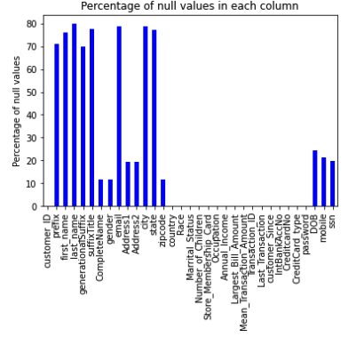
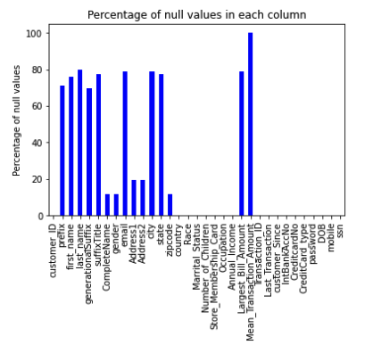
3. Metrics for Improvising the incompleteness
For Largest Transaction column :
Master Dataset [Largest Transaction column] we connected to the Database of the Transaction History table retriving the highest transaction amount and replacing the null values with the respected records in the master Dataset
Master Dataset
Transaction History Table
Present table
Metadata DB of PiLog Groups
Department of Information Science, Spring 2023 Master’s Thesis

Slide 11
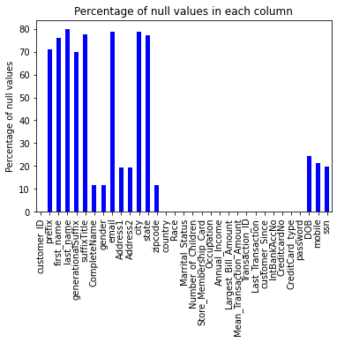
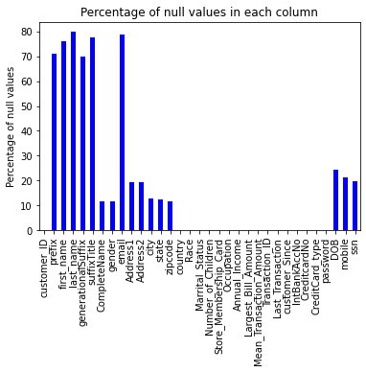
3. Metrics for Improvising the incompleteness
For State and city:
Use an API that can retrieve state information based on a given zipcode and replace in their respective columns of state and city if there is any null values in the Master data.
ENDPOINT = "http://api.zippopotam.us/us/"
Department of Information Science, Spring 2023 Master’s Thesis

Slide 12
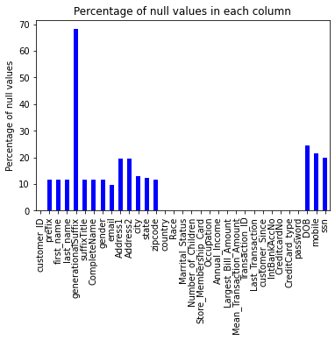
3. Metrics for Improvising the incompleteness
For Email and the Name parsers:
We follow rule based approach. We make sure there is no null in the Completename column if not we retrive from the PiLog Metadata and then parse it to their respective columns (data enrichment).
For email if the customer doesn’t have a email we provide them with a standard format of firstname.lastname@Pilog.com
Department of Information Science, Spring 2023 Master’s Thesis

Slide 13
3. Improvising the DQ dimension- validity
The Critical Attributes we focused on validity are:
SSN
Mobile number
Date of Birth
To reach your customers → need accurate mobile no as communication channel.
sales reps to call customers→ accurate phone number.
Identify invalid phone numbers.
Invalid data : → data that does not meet field specifications for accurate and useful records.
We classify Invalid and valid based on the Us standard rules
Department of Information Science, Spring 2023 Master’s Thesis
Notes:
To reach your customers, you need accurate data for your preferred communication channel.
If you want your sales reps to call customers, you will need an accurate phone number for them.
Identify invalid phone numbers.
Invalid data is data that does not meet field specifications for accurate and useful records.

Slide 14
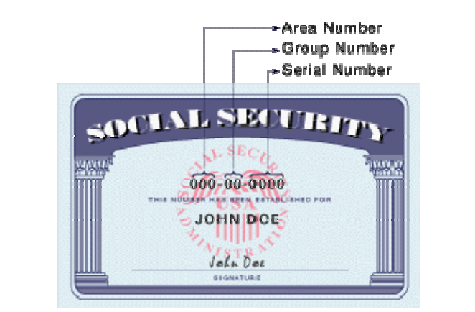
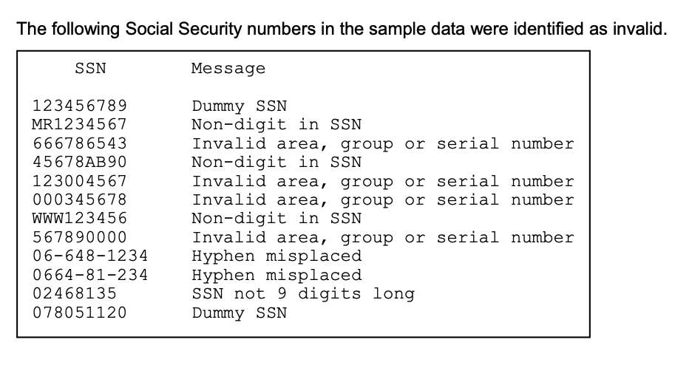
Improvising the DQ dimension- validity
Rules to classify valid and invalid SSN: ### - ## - ####
SSN is used in US to join the info from different sources
If SSN → invalid → Difficult to connect b/w DS
In processing data with SSNs is to identify invalid SSNs
Downloading information from the SSA web site
- Available with valid ranges for SSN area and group codes
filename ssn url 'http://www.socialsecurity.gov/employer/highgroup.txt’;
Department of Information Science, Spring 2023 Master’s Thesis
Notes:
In the United States, most individuals are identified by a Social Security number (SSN) assigned by the Social Security Administration (SSA).
An SSN can be used as a common key for joining information from different sources. If SSNs are invalid, joining different data sources is much more difficult, if not impossible. Therefore, one of the first steps in processing data with SSNs is to identify invalid SSNs. This paper describes a process for checking SSNs. An SSN consists of three sets of digits. The first set is the three-digit area number. The second set is the two-digit group number. The third set is the four-digit serial number. Often these sets of digits are shown separated by hyphens, so an SSN looks like this: 999-99-9999.

Slide 15
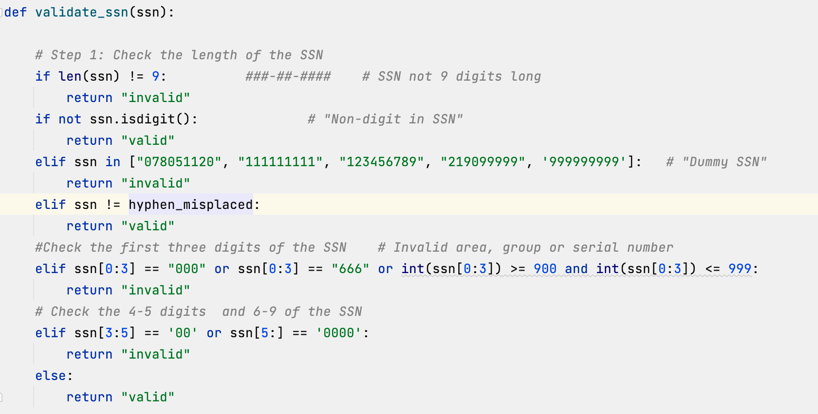
3. Improvising the DQ dimension- validity
Rules to classify valid and invalid SSN:
### - ## - ####
Department of Information Science, Spring 2023 Master’s Thesis
Notes:
DOWNLOADING INFORMATION FROM THE SSA WEB SITE
The Social Security Administration web site has a text file of information about the currently valid ranges for SSN area and group codes. SAS ® makes it easy to download files from a web site by using a FILENAME statement with the URL access method. It works like magic. filename ssn url 'http://www.socialsecurity.gov/employer/highgroup.txt';

Slide 16
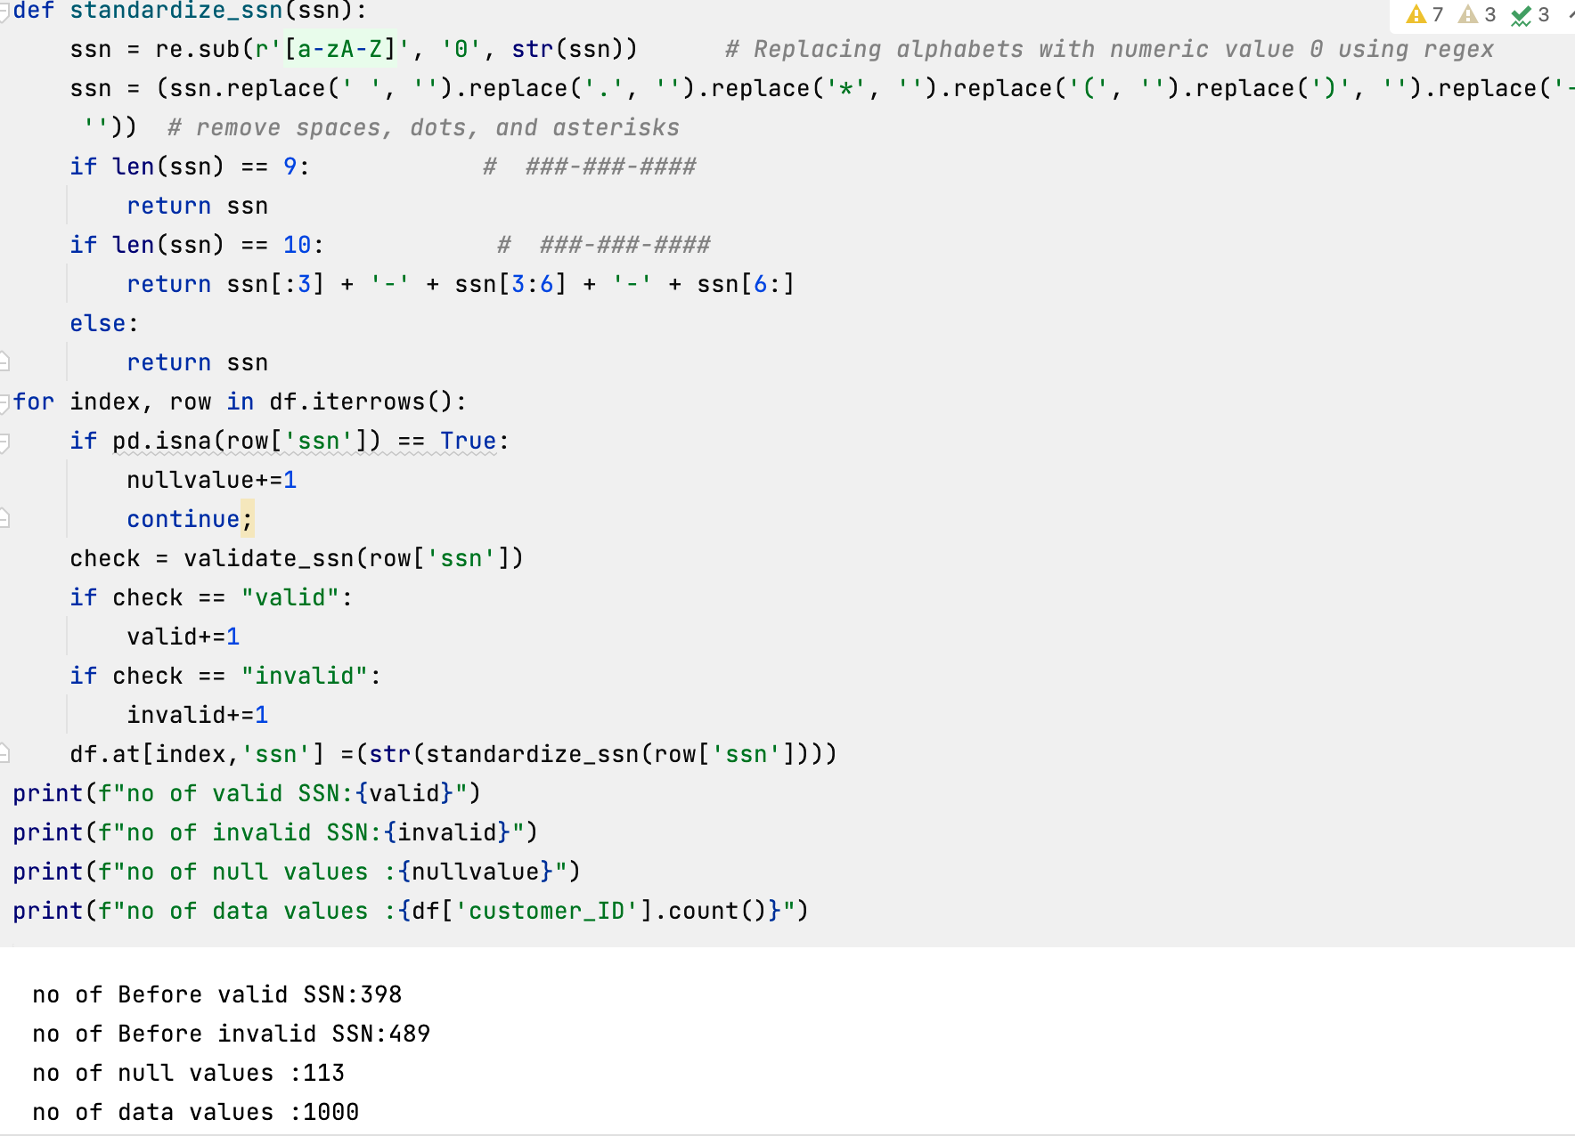
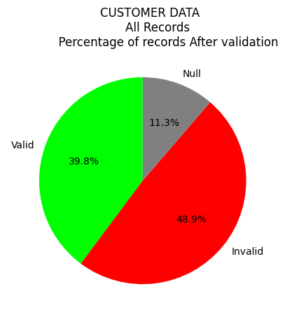
3. Improvising the DQ dimension- validity
Standardization rules for making standard format for SSN
formats
###-###-####
(###)#######
(###) ###-####
(###)-###-####
###.###.####
##########
(###) ###-####
### ### ####
##########
### * ### * ####
(###) ### . ####
### - #######
### . #######
(###) #######
(###)###-####
Department of Information Science, Spring 2023 Master’s Thesis
Notes:
DOWNLOADING INFORMATION FROM THE SSA WEB SITE
The Social Security Administration web site has a text file of information about the currently valid ranges for SSN area and group codes. SAS ® makes it easy to download files from a web site by using a FILENAME statement with the URL access method. It works like magic. filename ssn url 'http://www.socialsecurity.gov/employer/highgroup.txt';

Slide 17
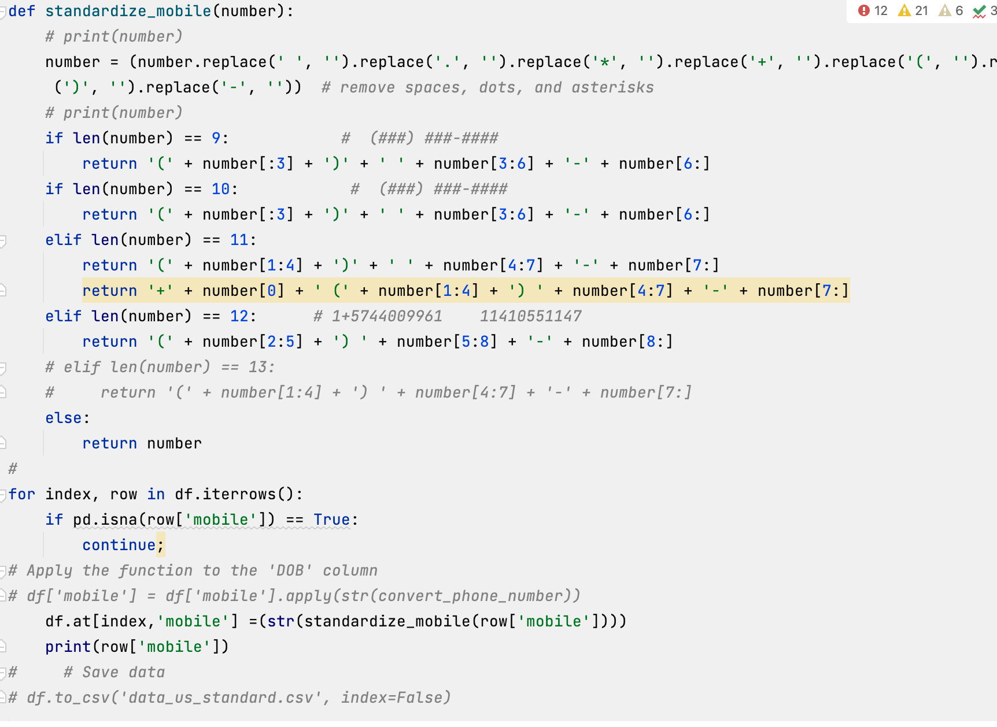
3. Improvising the DQ dimension- validity for mobile number
Standardization rules Rules for making standard format:
formats
###-###-####
(###)#######
(###) ###-####
(###)-###-####
###.###.####
1+##########
+(###) ###-####’
'### ### ####’
##########’
###*###*####
(###) ###.####
###-#######
###.#######’
###) #######
(###)###-####
Department of Information Science, Spring 2023 Master’s Thesis
Notes:
DOWNLOADING INFORMATION FROM THE SSA WEB SITE
The Social Security Administration web site has a text file of information about the currently valid ranges for SSN area and group codes. SAS ® makes it easy to download files from a web site by using a FILENAME statement with the URL access method. It works like magic. filename ssn url 'http://www.socialsecurity.gov/employer/highgroup.txt';

Slide 18
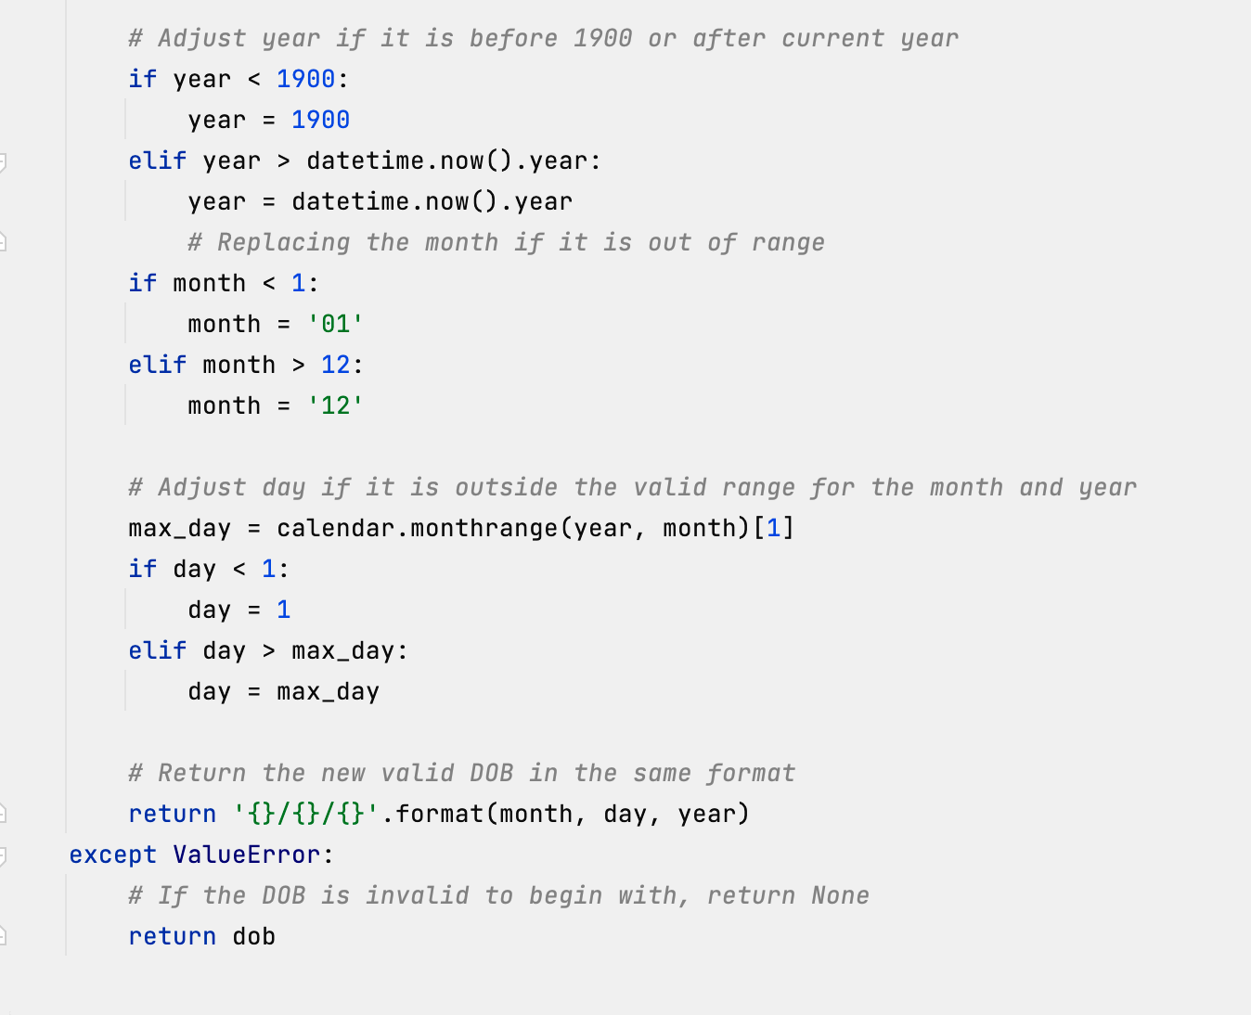
3. Improvising the DQ dimension- validity for Date of birth
Standardization rules
Department of Information Science, Spring 2023 Master’s Thesis
Notes:
DOWNLOADING INFORMATION FROM THE SSA WEB SITE
The Social Security Administration web site has a text file of information about the currently valid ranges for SSN area and group codes. SAS ® makes it easy to download files from a web site by using a FILENAME statement with the URL access method. It works like magic. filename ssn url 'http://www.socialsecurity.gov/employer/highgroup.txt';

Slide 19

Problem Statement for Uniqueness
1. Goal: To improve the Uniqueness.
2. Which approach to proceed to improve data Quality.
We proceed with 3 methods to improve the Uniqueness and compare the results based on Precision and recall.
They are:
RecordLinkage tool kit (Pairwise comparision)
Using Oyster
Splink
1. What are the Metrics to consider to resolve and Improvising the incompleteness?
4. Comparing the results with the Truth set / from the Organizational metadate
Department of Information Science, Spring 2023 Master’s Thesis
19

Slide 20
3. Improvising the DQ dimension- Uniqueness
Uniqueness:
Most Critical dimension to ensure no duplication of records.
Measured with in the dataset or across the dataset
Data uniqueness also improves Data Governance and speeds up compliance.
Entity Resolution is a strategy for finding records that refer to the same real-world entity in different data sources or within the same data source.
In this even the strings are nearly identical.
To improve the uniqueness we are using RecordLinkage Package to link and deduplicate the records.
Department of Information Science, Spring 2023 Master’s Thesis
Notes:
In Entity Resolution, the strings that are nearly identical, but maybe not exactly the same, are matched without having a unique identifier.

Slide 21
3. Improvising the DQ dimension- Uniqueness
Purpose → To find the duplicates between two datasets.
There are two main types of record linkage:
Deterministic Record Linkage:
It involves doing matches and joins on data to find duplicates
Easier, Suitable for data having high level of inaccuracy.
Probabalistic Record Linkage:
Calculates based on the probability that two records matches or not.
Further uses ML Algorithms to classify and find matches automatically using confusion matrix.
Department of Information Science, Spring 2023 Master’s Thesis
Notes:
In Entity Resolution, the strings that are nearly identical, but maybe not exactly the same, are matched without having a unique identifier.

Slide 22
3. Improvising the DQ dimension- Uniqueness
RecordLinkageToolKit:
1st stage:
Preprocess the data(cleaning, detecting anamolies)
Adding phonetic version of the name using the soundex method
2nd stage: Indexing and Blocking
Identifying the candidate pairs (possibllity of having matches)
Blocking using the Phonetic_Initials
Generated multiindex showing each candidate pair
3rd Stage: Comparisions
It measures the difference between each of the record features → determines level of similar in the feature
Using the "jarowinkler" algorithm on all the strings
Results in scaling the similarity between 0 -1 range.
4th stage: Classification: Match or No-match
Selecting a arbitrary score and sum up the comparision values
If (cand_pair > arbitrary score) → match
Department of Information Science, Spring 2023 Master’s Thesis
Notes:
In computer science and statistics, the Jaro–Winkler similarity is a string metric measuring an edit distance between two sequences.

Slide 23
3. Metrics using in RecordLinkage method
Metrics used for performace Evaluation:
Precision: How many were right matches?
Recall: How many matches we miss?
Procedure:
Set the scores that include whole numbers from 0 to 7.
If Score ~ 7 → Precision Increases → ( Gets less FP). →But recall
Best optimal score we get is somewhere between 6 and 7.
Further we can introduce ML algorithm (having numerical values) like SVM
Department of Information Science, Spring 2023 Master’s Project
Notes:
In computer science and statistics, the Jaro–Winkler similarity is a string metric measuring an edit distance between two sequences.

Slide 24
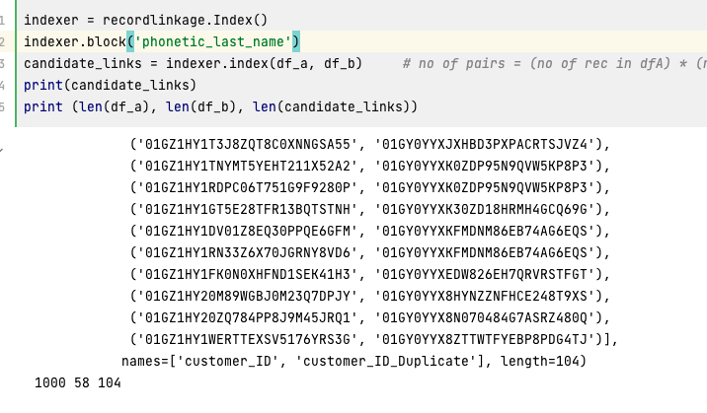
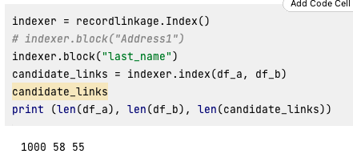
3. Metrics using in RecordLinkage method
Comparing the results based on Blocking and classification
Blocking:
using exact last_name
Using Phonetic Soundex Blocking
Department of Information Science, Spring 2023 Master’s Project
Notes:
In computer science and statistics, the Jaro–Winkler similarity is a string metric measuring an edit distance between two sequences.

Slide 25
3. Metrics using in RecordLinkage method and Oyster Results
Comparing the results
Oyster Results
RecordLinkage method
Total Count:114 Pairs:50 Clusters:64 Total Distinct Records ID values (N) ............... = 114 ---------------------Clusters ---------------------- Reference Set Clusters (EC) ........................ = 58 Link Set Clusters (LC) ............................. = 62 Reference+Link Set Agreement Clusters (AC) ......... = 64 ---------------------Pairs ------------------------- Total Pairs (D) = ((N * N-1) / 2) .................. = 6,441 Reference Set Pairs (E) ............................ = 56 Link Set Linked Pairs (L) .......................... = 54 Reference+Link Set Agreement Pairs (A) ............. = 50 True Positive Pairs (TP) ........................... = 50 False Positive Pairs (FP) = L - TP ................. = 4 True Negative Pairs (TN) = D - TP - FP - FN ........ = 6,381 False Negative Pairs (FN) = E - TP ................. = 6 ---------------------Rates - (0.0 - 1.0) ----------- False Positive Rate = FP / (TN + FP) ............... = 0.00062647 False Negative Rate = FN / E ....................... = 0.10714286 Accuracy = (TP + TN) / D ........................... = 0.99844745 Precision = TP / (TP + FP) ......................... = 0.92592593 Recall = TP / (TP + FN) ............................ = 0.89285714 F-Measure .......................................... = 0.90909091 TWi ................................................ = 0.93697902
when score is 0 precision is 0.5192307692307693 and recall is 0.9310344827586207
when score is 1 precision is 0.5192307692307693 and recall is 0.9310344827586207
when score is 2 precision is 0.5346534653465347 and recall is 0.9310344827586207
when score is 3 precision is 0.7397260273972602 and recall is 0.9310344827586207
when score is 4 precision is 0.9642857142857143 and recall is 0.9310344827586207
Department of Information Science, Spring 2023 Master’s Project
Notes:
In computer science and statistics, the Jaro–Winkler similarity is a string metric measuring an edit distance between two sequences.

Slide 26
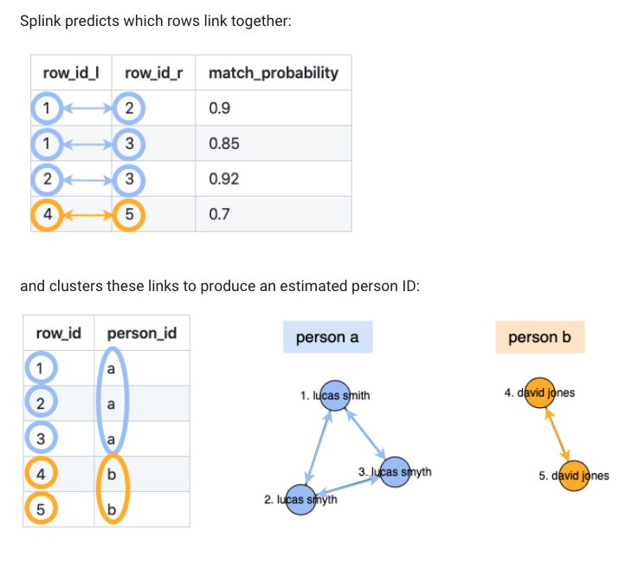
Method -3
Using SPlink:
probabilistic record linkage (entity resolution) → deduplicate and link W/O identifiers.
Blocking using Pairwise Comparisions.
Linkage Algorithm based on Fellegi-Suter's statistical model.
Best fit for data with multiple colums (are not highly correlated)
types of data linking:
1. dedupe_only, splink --> find duplicates, for single input dataset.
2. link_and_dedupe, splink --> finds links within and between input datasets
for two or more input datasets.
3. link_only, splink --> finds links between datasets,
but does not attempt to deduplicate the datasets for two or more input datasets.
Department of Information Science, Spring 2023 Master’s Project
Notes:
In computer science and statistics, the Jaro–Winkler similarity is a string metric measuring an edit distance between two sequences.

Slide 27
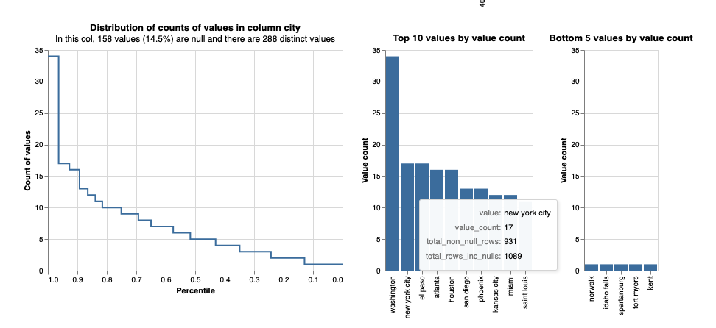
Analyse the distribution of values in your data
Columns with higher cardinality (number of distinct values) The skew of values is important.
Department of Information Science, Spring 2023 Master’s Project
Notes:
In computer science and statistics, the Jaro–Winkler similarity is a string metric measuring an edit distance between two sequences.

Slide 28
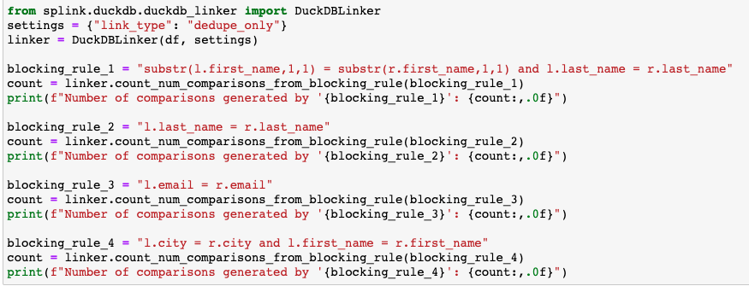
Analyse the distribution of values in your data
Blocking rules based on pairwise matching with using index_id
Number of comparisons :
substr(l.first_name,1,1) = substr(r.first_name,1,1) and l.last_name = r.last_name: 52
l.last_name = r.last_name: 71
l.email = r.email: 216
l.city = r.city and l.first_name = r.first_name: 8
Department of Information Science, Spring 2023 Master’s Project
Notes:
In computer science and statistics, the Jaro–Winkler similarity is a string metric measuring an edit distance between two sequences.

Slide 29
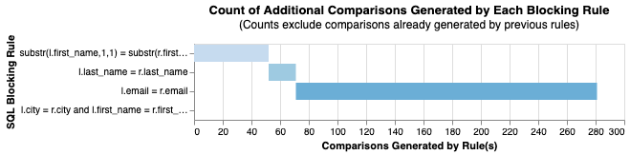
cumulative_num_comparisons_from_blocking_rules_chart
Department of Information Science, Spring 2023 Master’s Project
Notes:
In computer science and statistics, the Jaro–Winkler similarity is a string metric measuring an edit distance between two sequences.

Slide 30
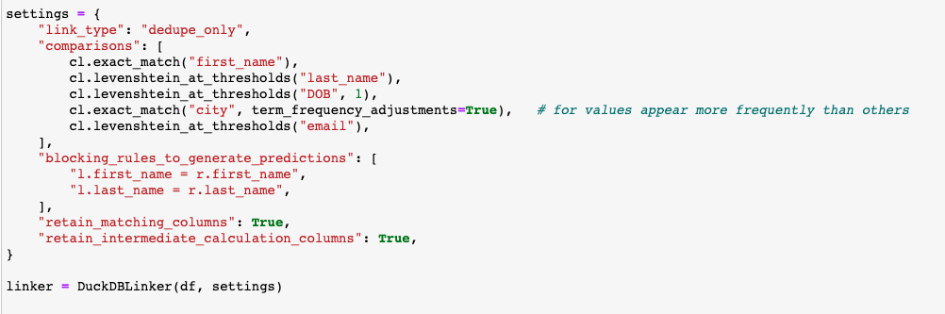
Department of Information Science, Spring 2023 Master’s Project
Notes:
In computer science and statistics, the Jaro–Winkler similarity is a string metric measuring an edit distance between two sequences.

Slide 31
Estimate the parameters of the model
probability_two_random_records_match parameter:
probability that two records taken at random represent a match
The u values :
proportion of records in each ComparisonLevel for truly non-matching records.
The m values:
proportion of records in each ComparisonLevel for truly matching records
Department of Information Science, Spring 2023 Master’s Project
Notes:
In computer science and statistics, the Jaro–Winkler similarity is a string metric measuring an edit distance between two sequences.

Slide 32
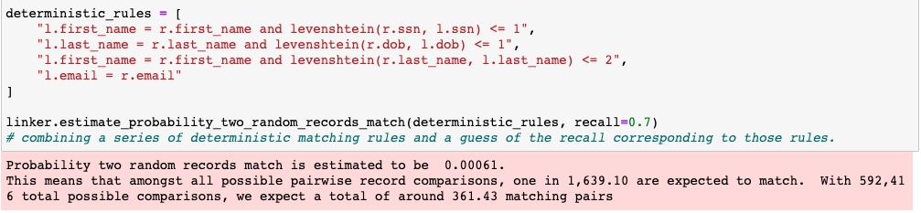
Estimate the parameters of the model
probability_two_random_records_match parameter:
It follows Deterministic rules
Department of Information Science, Spring 2023 Master’s Project
Notes:
In computer science and statistics, the Jaro–Winkler similarity is a string metric measuring an edit distance between two sequences.

Slide 33
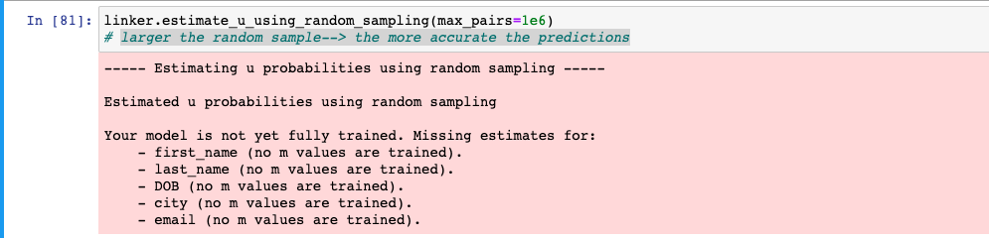
Estimate the parameters of the model
The u values :
larger the random sample → the more accurate the predictions
Department of Information Science, Spring 2023 Master’s Project
Notes:
In computer science and statistics, the Jaro–Winkler similarity is a string metric measuring an edit distance between two sequences.

Slide 34
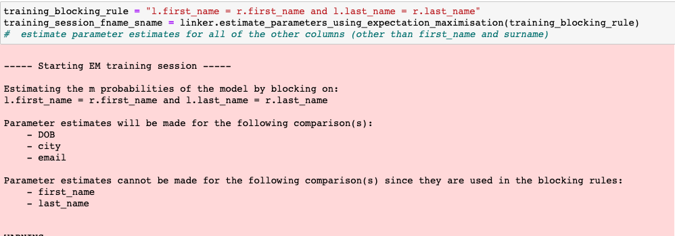
Estimate the parameters of the model
The m values :
Estimating the parameter for all of the other columns by blocking (other than first_name and surname) using EM (Expectation Maximization Algorithm)
Department of Information Science, Spring 2023 Master’s Project
Notes:
In computer science and statistics, the Jaro–Winkler similarity is a string metric measuring an edit distance between two sequences.

Slide 35
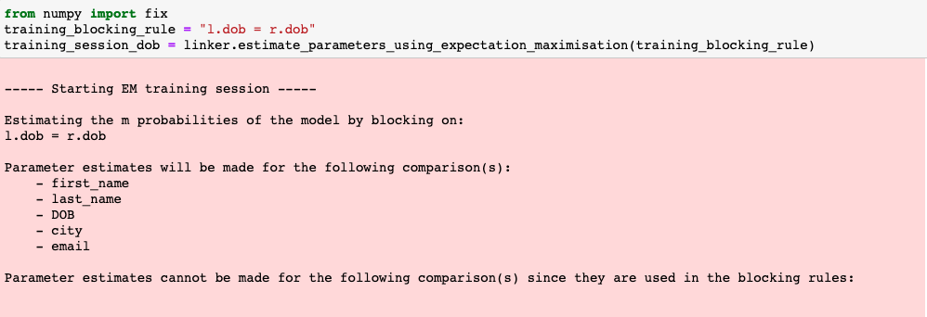
Estimate the parameters of the model
The m values :
Estimating the parameter for all of the other columns by blocking (other than first_name and surname) using EM (Expectation Maximization Algorithm)
Department of Information Science, Spring 2023 Master’s Project
Notes:
In computer science and statistics, the Jaro–Winkler similarity is a string metric measuring an edit distance between two sequences.

Slide 36
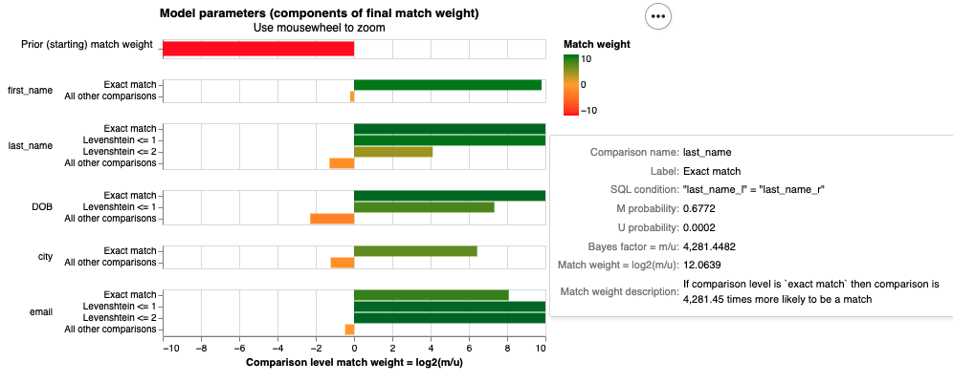
Visualising model parameters
Department of Information Science, Spring 2023 Master’s Project
Notes:
In computer science and statistics, the Jaro–Winkler similarity is a string metric measuring an edit distance between two sequences.

Slide 37
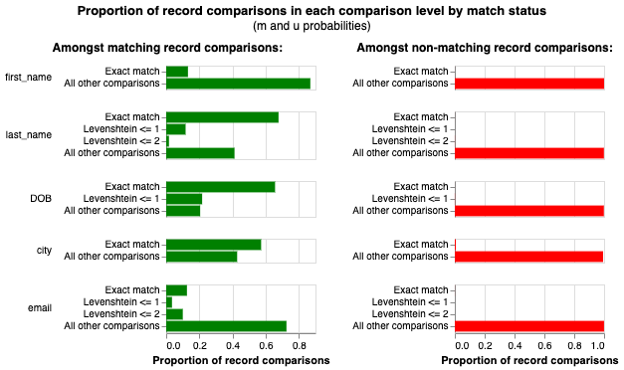
Visualizing model parameters
Department of Information Science, Spring 2023 Master’s Project
Notes:
In computer science and statistics, the Jaro–Winkler similarity is a string metric measuring an edit distance between two sequences.

Slide 38
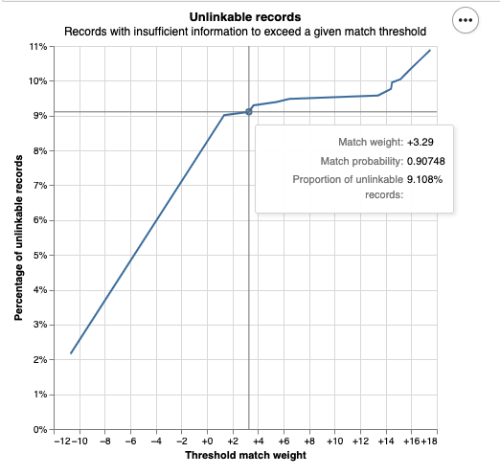
Detecting unlinkable records
Unlinkable records are those which do not contain enough information to be linked.
Unlinkable records can be found by linking records to themselves
if, even when matched to themselves, they don't meet the match threshold score,
we can be sure they will never link to anything.
Department of Information Science, Spring 2023 Master’s Project
Notes:
In computer science and statistics, the Jaro–Winkler similarity is a string metric measuring an edit distance between two sequences.

Slide 39
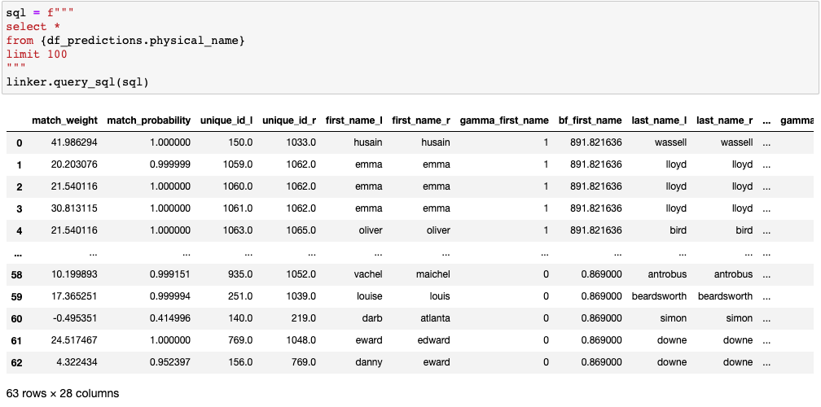
Matching based on Match weight and match probability
resulted Matching records = 63
Department of Information Science, Spring 2023 Master’s Project
Notes:
In computer science and statistics, the Jaro–Winkler similarity is a string metric measuring an edit distance between two sequences.

Slide 40
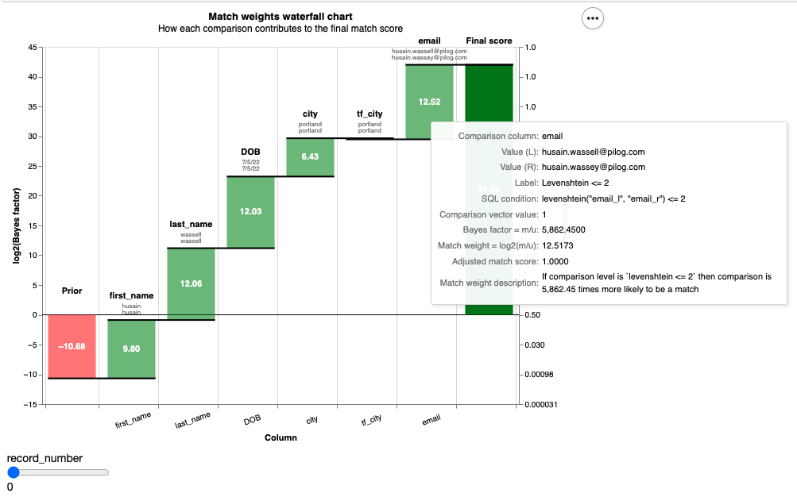
Match weight Waterfall Chart
Cumulative comparisions for final match score
Department of Information Science, Spring 2023 Master’s Project
Notes:
In computer science and statistics, the Jaro–Winkler similarity is a string metric measuring an edit distance between two sequences.

